Slide 1
We acknowledge Aboriginal and Torres Strait Islander people as the traditional custodians of the land upon which we meet.
We pay our respects to the elders of the past, present and future and acknowledge their spiritual connection to country.

Slide 2
Welcome to your Partnership Program
INSPIRE + ENGAGE
Notes:
Teaching and Learning Program + RY Survey
Teacher PD!?

Slide 3
OVERVIEW
Purpose
Purpose? Set the school up with resources?
✔ Discover the components of the School Partnership Program
✔ Be equipped with a timeline for successful implementation in 2023
THE WHAT
Teaching + Learning Program | INSPIRE + ENGAGE
Resources | Online Resource Hub
Measuring Student Wellbeing | Resilient Youth Survey
Beyond the Classroom | Additional Resources
THE HOW
Implementation | Timeline + Checklist

Slide 4
INSPIRE
STUDENTS
ENGAGE
WHOLE SCHOOL APPROACH
PARENTS & CARERS
STAFF
Notes:
Whole school approach
Start with Inspire and move into Engage
Students, staff, parents and carers

Slide 5
GRATITUDE
Paying attention to the things that we have right now, and not worrying about what we don’t have. We practice this by noticing the positives that exist around us.
EMOTIONAL LITERACY
EMPATHY
Our ability to label our emotions as we experience them. Labelling our emotions helps us to manage our emotions (soften negative emotions and find positive emotions). We practice this by labelling our emotions as we experience different parts of our day.
Putting ourselves in the shoes of others to feel and see what they do. We practice this through being kind and compassionate towards other people.
MINDFULNESS
Our ability to be present at any given moment. We practice this through slowing down and concentrating on one thing at a time. This could be our breathing, completing a colouring sheet or noticing the noises we can hear.
Notes:
These are our guiding principles
Every single lesson in the curriculum is based on these
I’m not going to read them out now but please refer to them and I encourage you to share these with your staff to build their understanding of the the concepts and parents

Slide 6
INSPIRE
Inspire
Notes:
EK
Our first phase focuses on inspiring the whole community and we do this by coming into your community for what we call a cluster week

Slide 7
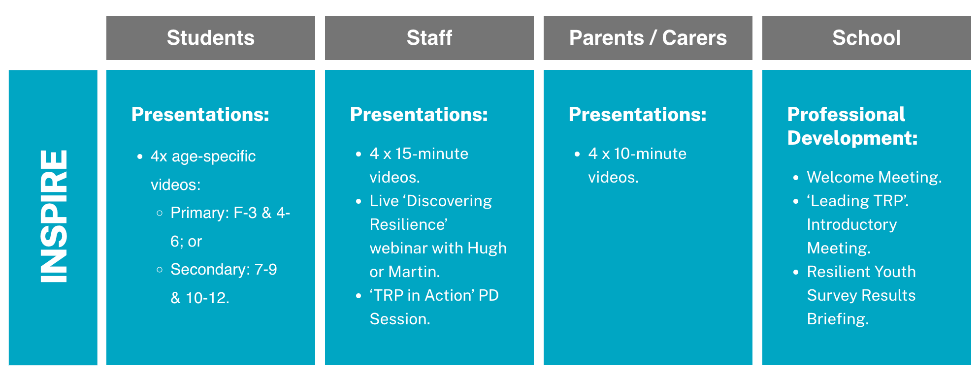
INSPIRE
Notes:
This is an overview of what the Inspire component incorporates

Slide 8
INSPIRE
Digital Presentation Delivery
TERM 1
TERM 2
Setting up a successful program within the school
Embedding the program in your school community
WEEK 1-4
WEEK 5-8
TBC
WEEK 1-5
TBC
Digital Staff Presentations
Use PD days and staff meetings
Digital Student Presentations
1 x weekly with lesson delivery
‘TRP in Action’ PD
SPM will confirm date
Parent and Carer Hub
Share using suggested communications from TRP
‘Discovering Resilience’ webinar with Hugh or Martin
Notes:
Term 1 Focus
Term 2 Focus
Staff delivery - Staff - build engagement and understanding - time to reflect and ask any questions before presenting to the students
Two approaches: slower roll out and a faster roll out
Mini PD sessions - 1 per week at the beginning of each meeting
Staff PD day - carve out some time to deliver all the staff presentations and work through the activities
Student delivery - combine the presentation and the lesson each week - complete in the order set out
Use a lesson to match with a video
3 suggested activities that relate to the video that are separate to the lessons
Can either clump together, or do over the 4 week period. It’s not the weeks that are important, but the order of the delivery.
Parents - Term 2, encourage TRP@Home as a beginning point
TRP in Action - we will give you the date and make sure it works for you.

Slide 9
ENGAGE
Engage
Notes:
Lil
After the whole community, staff, students and families have been inspired by the digital presentations, we move into the ENGAGE phase

Slide 10
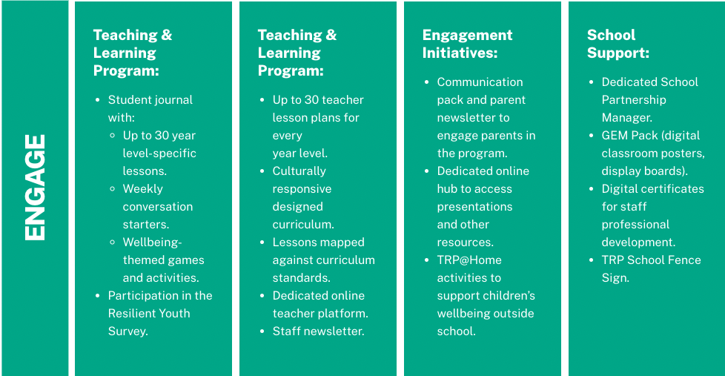
ENGAGE
Students
Staff
Parents/Carers
School
Notes:
Explicit Teaching and Learning Program

Slide 11
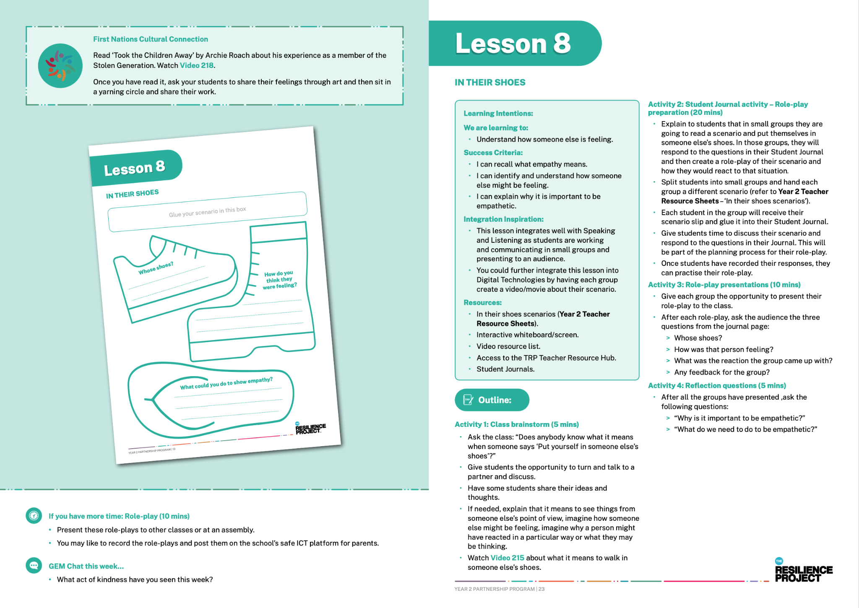
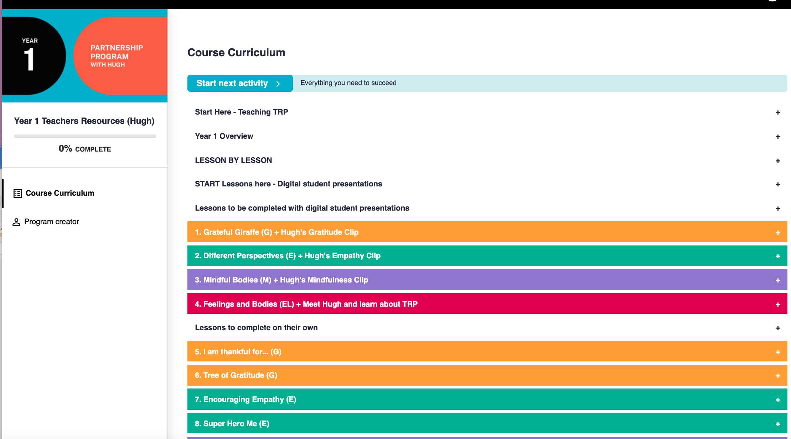
ENGAGE
Lesson Plans (Teaching Resource)
Teachers receive a comprehensive, year level specific teaching resource with detailed lesson plans for the year.
Student Journals
Each student receives their own student journal to help them complete the curriculum. These journals link directly with the lesson plans.
Online Resource Hub
Teachers will be provided access to the TRP Resource Hub where they will find everything they need to effectively deliver the curriculum.
Notes:
Lil
Our aim is to set you up for success by providing you with all the resources you need to deliver the program effectively;
When it comes to engaging the students in the lessons, you will have detailed lesson plans for each year group
Students will each have their own student journal to help them complete the curriculum and they are directly linked to the lesson plans
All the lesson plans are housed on our online resource hub where you will find everything you need to effectively deliver the curriculum
Importance of the using the logging on online resource hub

Slide 12
ENGAGE
Classroom Lesson Delivery
DESIGNED FOR 1 HOUR OF WELLBEING CONTENT PER WEEK
WHERE + WHEN
Decide where TRP fits into the school timetable
Clear space to allow time for teachers to deliver the program
WHO
Identify who is going to deliver the TRP program (Secondary)
WHAT & HOW?
Consider the makeup of your classes e.g. composite classes
Adapt to your school’s unique setting
Notes:
Designed for 1hr of wellbeing content per week
Deliver 1 hr session per week
Deliver 2 x 30 min sessions per week

Slide 13
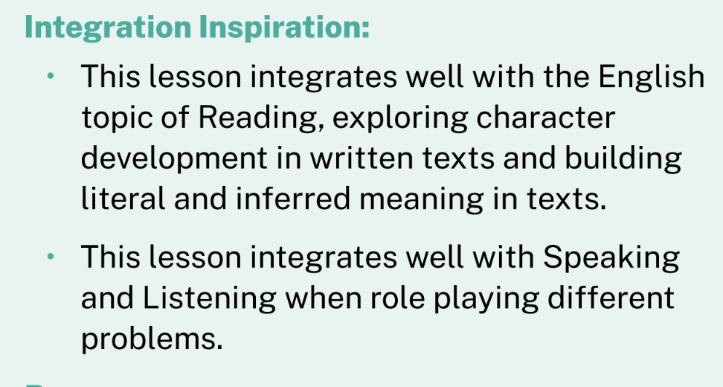
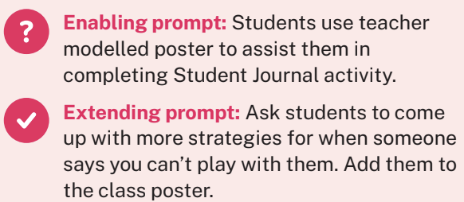
LESSON FEATURES
PRIMARY
Up to 30 year level specific lessons
✔ 1 hour duration
✔ Learning Intentions
✔ Success Criteria
✔ Fully mapped to Aus Curriculum
GEM CHAT FOCUS
INTEGRATION PROMPTS
CULTURAL CONNECTION PROMPTS
DIFFERENTIATION PROMPTS
Notes:
The first 4 lessons are aligned with the student presentations

Slide 14
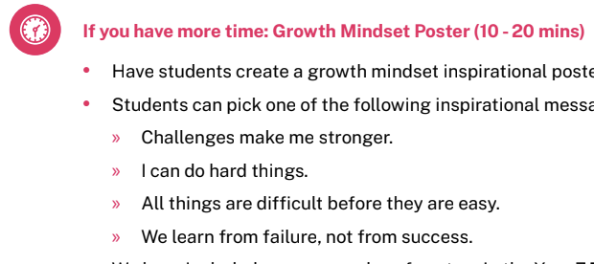
LESSON FEATURES
SECONDARY
✔ 50 x 25 min lessons OR 25 x 50 min lessons
✔ 2 x inquiry units (up to 6 hrs of content)
✔ Learning Intentions
✔ Fully mapped to Aus Curriculum
GEM CHAT FOCUS
EXTRA TIME
CULTURAL CONNECTION PROMPTS
DIFFERENTIATION PROMPTS
Notes:
The first 4 lessons are aligned with the student presentations

Slide 15
Online Resource Hub

Slide 16
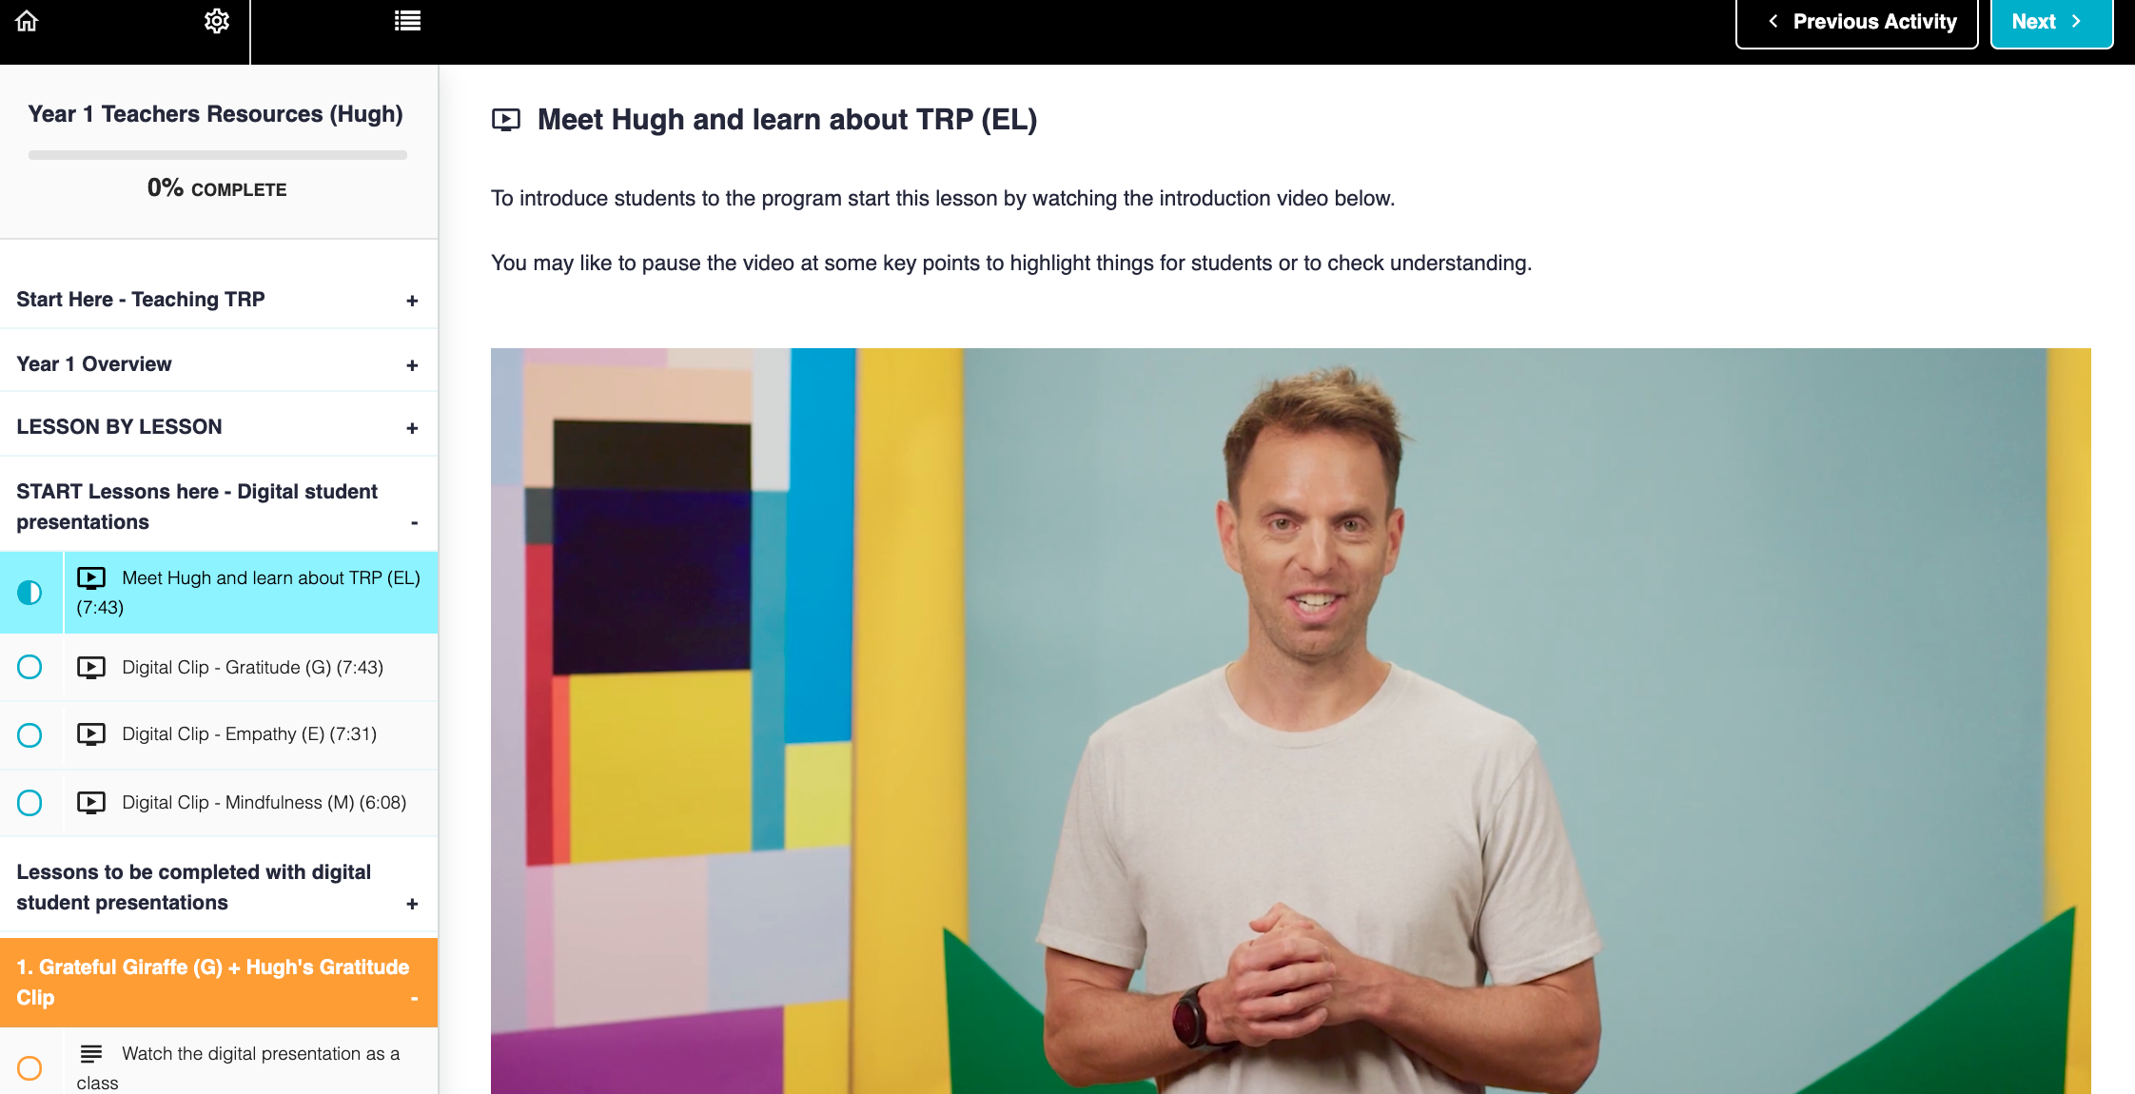
ENGAGE
Online Resource Hub
ALL CURRICULUM MATERIALS
Everything you need to teach the program!
✔ Lesson plans
✔ Student journal pages
✔ Resource sheets
✔ Videos
✔ Meditations
SUPPORT MATERIALS
✔ Curriculum Mapping Documents
✔ Teaching TRP guide
PLUS…
✔ Staff Self-Care
✔ Project +
✔ And much more!
Notes:
Log in and show how to navigate - embed pre-recorded video for future reference?

Slide 17
Resilient Youth Survey

Slide 18
ENGAGE
TRP CURRICULUM
Resilient Youth Survey
Wellbeing Profile
of your school which can be tracked year on year
Survey
Primary - Shortened
Secondary - 62 questions
35-50 mins to complete
Term 1
Term 2/Term 3
Students complete survey to
capture student wellbeing
Resilience Profile Workshop
with the leadership team to unpack findings to inform future directions
Notes:
EK 1. To help you understand the current mental health and wellbeing of your students, the Resilient Youth Survey measures key indicators such as life satisfaction, hopefulness, anxiety and depression, coping style, and risk and protective behaviours.
2. Students complete a survey which then provides aach school with a Resilience Profile of their students to measure year-on-year and against national standards.
3. The survey is informed by gold standard mental health constructs in order to best capture the mental wellbeing of your students
4. Schools find this to be a key element of the program and they are provided with support in unpacking the findings to identify areas where things are going well and to identify opportunities for improvement

Slide 19
Beyond the Classroom

Slide 20
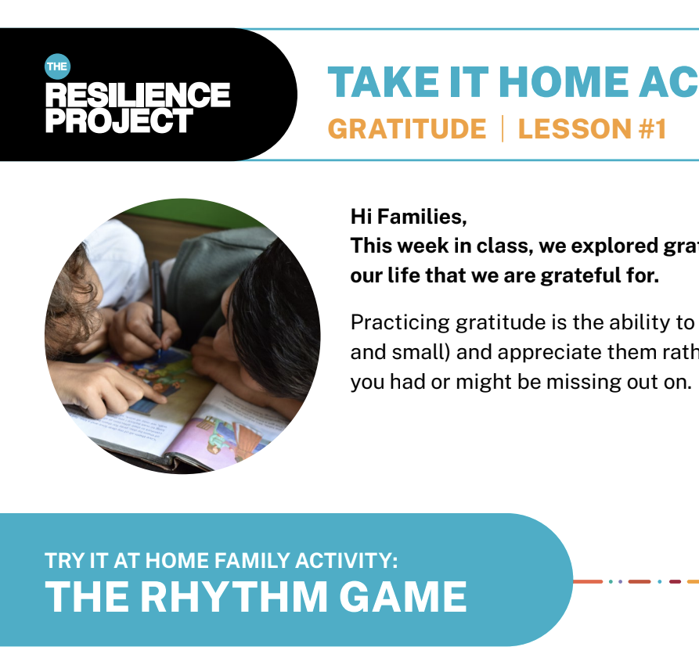
ENGAGE
TRP CURRICULUM
Beyond the Classroom
GEM Chats
Newsletters
Take It Home
TRP@HOME
Podcast
Notes:
EK
The program then goes beyond the classroom via these three avenues which compliment the program nicely
A GEM chat guide which engages teachers, students and families in the practice of gratitude, empathy and mindfulness daily
We also have a newsletter titled Project + which goes out 6 times per year with a whole bunch of ideas to embed GEM within the school and the home
We also have TRP@HOME which is a place filled with inspiration and activities that children and families can do at home to help improve their wellbeing and build resilience find really useful

Slide 21
Implementation
Notes:
Lil

Slide 22
IMPLEMENTATION
TRP Ambassador
As TRP Ambassador, you will;
School
Professional Development
Be your school’s key contact
Oversee the program across the school
Receive TRP merchandise
Be provided with networking opportunities with other Partnership School
Have access to additional Professional Development
Receive early bird access to our TRP Teacher Seminar

Slide 23
IMPLEMENTATION
Preparing for 2023
TERM 4
OCT
NOV
DEC
Order Curriculum
Complete Curriculum Order form to receive access to online resource hub as early as November
Online Resource Hub
Allocate time in a staff meeting to introduce TRP to your staff and show them how to login to the online resource hub.
*Use these slides and adapt to your setting
‘Leading TRP at your school’ webinar
Date TBC
*For staff leading the program within your school
Notes:
Order form will come out first of oct - do your ordering in the first month, teachable access, 1st of nov, don’t order before them, Teachable access after

Slide 24
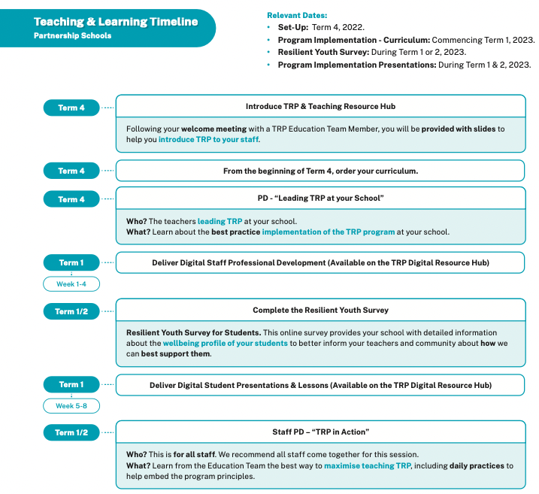
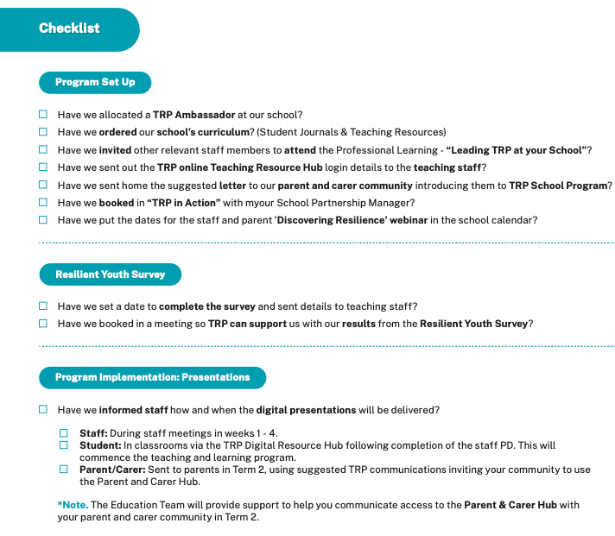
IMPLEMENTATION
Checklist
Notes:
It is a great idea to use the checklist provided to you in your “Welcome Pack” to complete all the necessary components of a great program.

Slide 25
@hughvancuylenburg
/theresilienceproject

